Slide 1
Visual diagnostics for more informed machine learning
Rebecca Bilbro
District Data Labs

Slide 2
Nice to meet you

Slide 3
Where this is going
Kansas
Oz
Yellow brick road
Ruby slippers

Slide 4
true or false:
“Machine learning is hard”
?

Slide 5
true or false:
“Machine learning is hard”
?

Slide 6
from sklearn.linear_model import LinearRegression model = LogisticRegression() model.fit(X,y) model.predict(X)

Slide 7
How to do it
Get data
Prep data
Pick model
Fit model
Validate model
Use model

Slide 8
How to do it
Get data
Prep data
Pick model
Fit model
Validate model
Use model

Slide 9
Prep data, aka “Feature analysis”

Slide 10
Pick model

Slide 11
Fit model
from sklearn.linear_model import LinearRegression model = LogisticRegression() model.fit(X,y) model.predict(X)

Slide 12
Validate model

Slide 13
Every estimator has advantages and drawbacks
Generalization error
Bias - average error for different training sets (Simplicity)
Variance - how sensitive it is to varying training sets (Specificity)
Noise - property of the data

Slide 14
High Bias? Try:
High Variance? Try:
Adding more features
Decreasing penalty/regularization on current features
Adding complexity/a more sophisticated model (e.g. increasing polynomial degree)
Using fewer features
Training on more samples
Increasing regularization

Slide 15
Tools for Evaluation: Regression
Metric | Measures | In Scikit-learn
Mean Square Error (MSE, RMSE) | distance between predicted values and actual values (more sensitive to outliers) | from sklearn.metrics import mean_squared_error
Absolute Error (MAE, RAE) | distance between predicted values and actual values (less sensitive to outliers) | from sklearn.metrics import mean_absolute_error from sklearn.metrics import median_absolute_error
Coefficient of Determination (R²) | % of variance explained by the regression; how well future samples are likely to be predicted by the model | from sklearn.metrics import r2_score

Slide 16
Tools for Evaluation: Classification
Metric | Measures | In Scikit-learn
Precision | How many selected items are relevant? | from sklearn.metrics import precision_score
Recall | How many relevant items were selected? | from sklearn.metrics import recall_score
F1 | Weighted average of precision & recall | from sklearn.metrics import f1_score
Confusion Matrix | True positives, true negatives, false positives, false negatives | from sklearn.metrics import confusion_matrix
ROC | True positive rate vs. false positive rate as classification threshold varies | from sklearn.metrics import roc
AUC | Aggregate accuracy as classification threshold varies | from sklearn.metrics import auc

Slide 17
true or false:
“Informed machine learning is hard”
?

Slide 18
true or false:
“Informed machine learning is hard”
?

Slide 19

Notes:
http://tikiloungetalk.com/wp-content/uploads/2010/11/dorothy.jpg

Slide 20
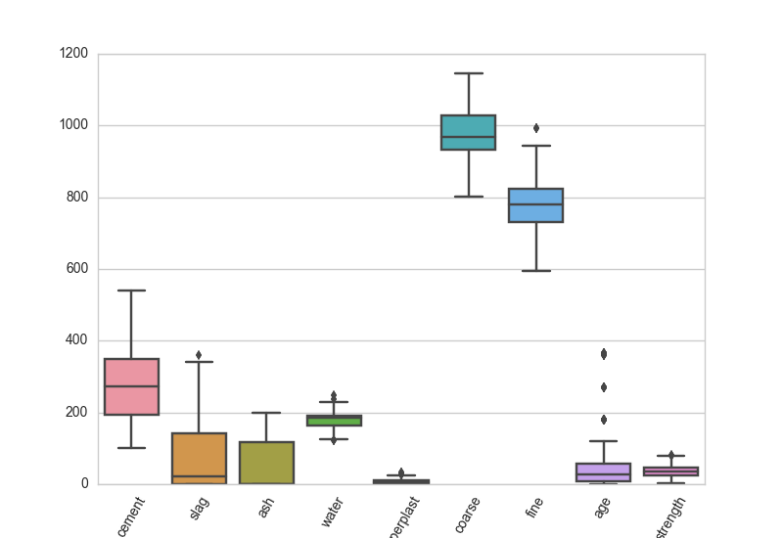
Visual feature analysis

Slide 21
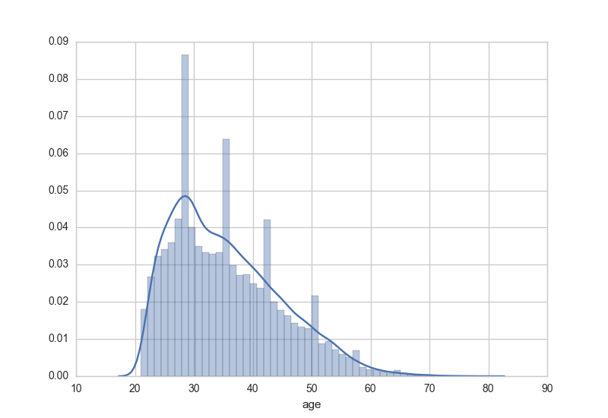
Visual feature analysis

Slide 22
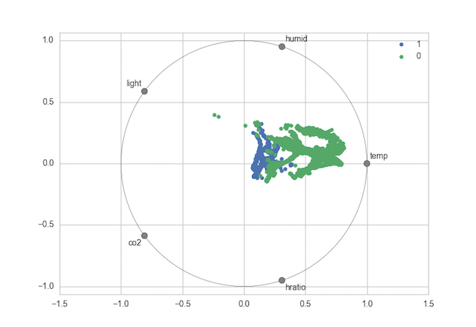
Visual feature analysis

Slide 23
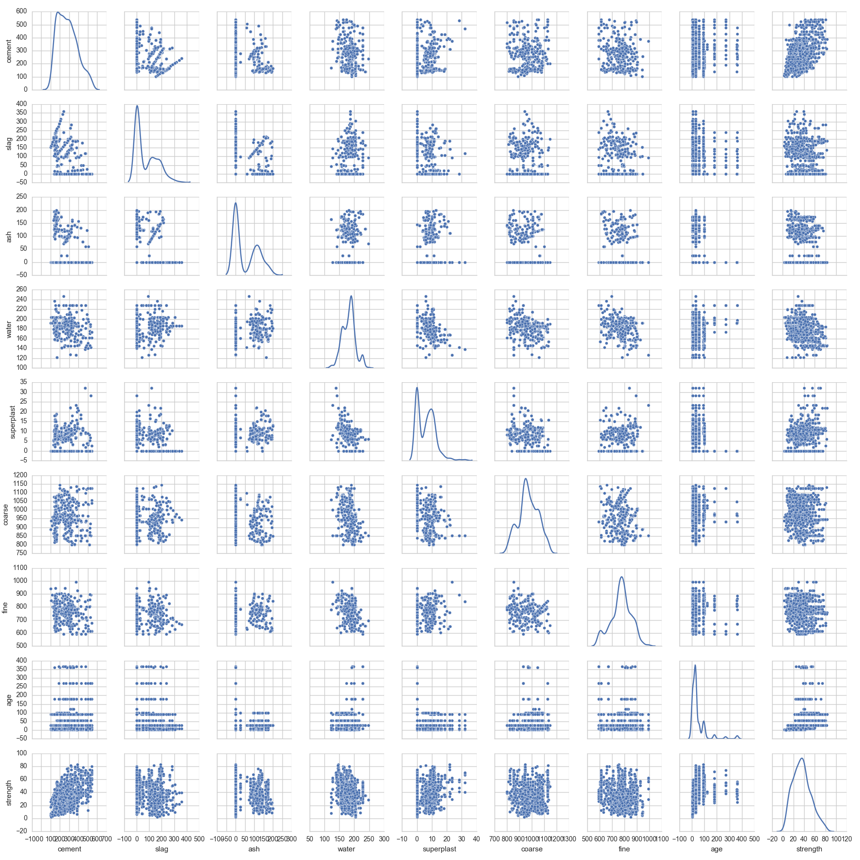
Visual feature analysis

Slide 24
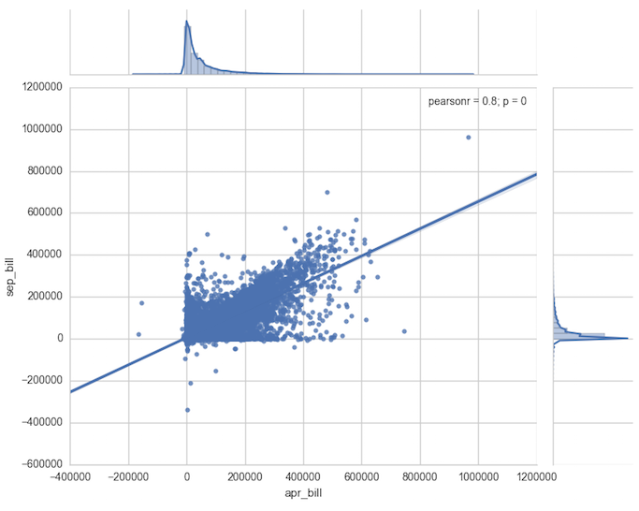
Visual feature analysis

Slide 25
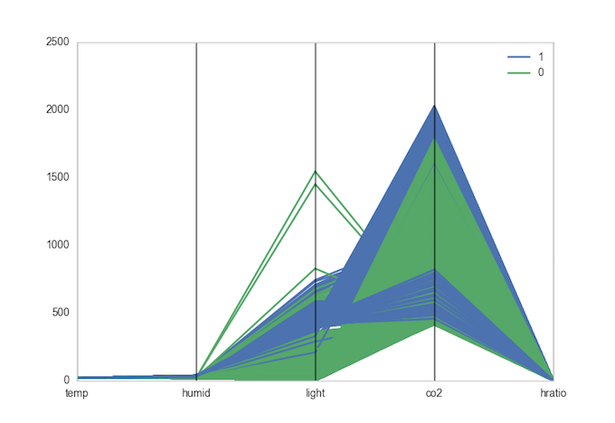
Visual feature analysis

Slide 26
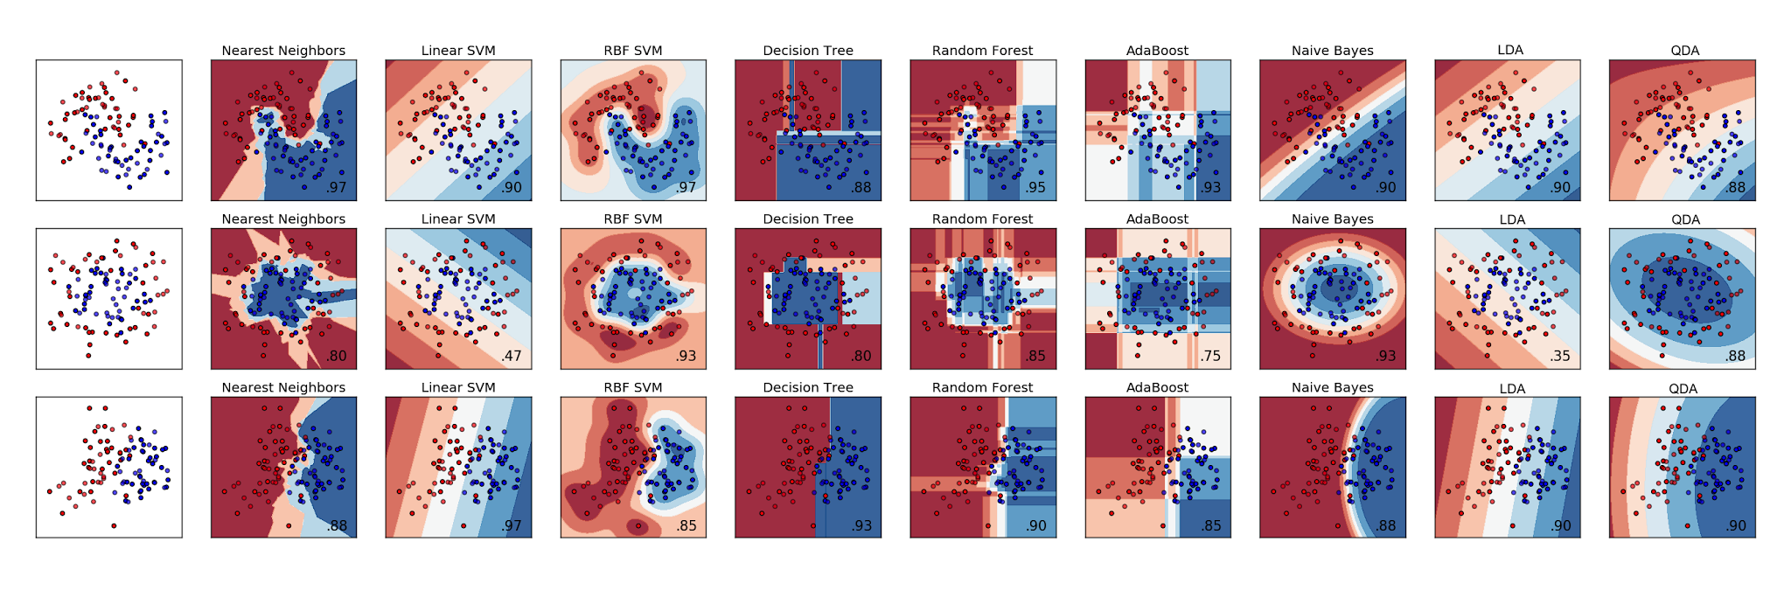
Visual model selection

Slide 27
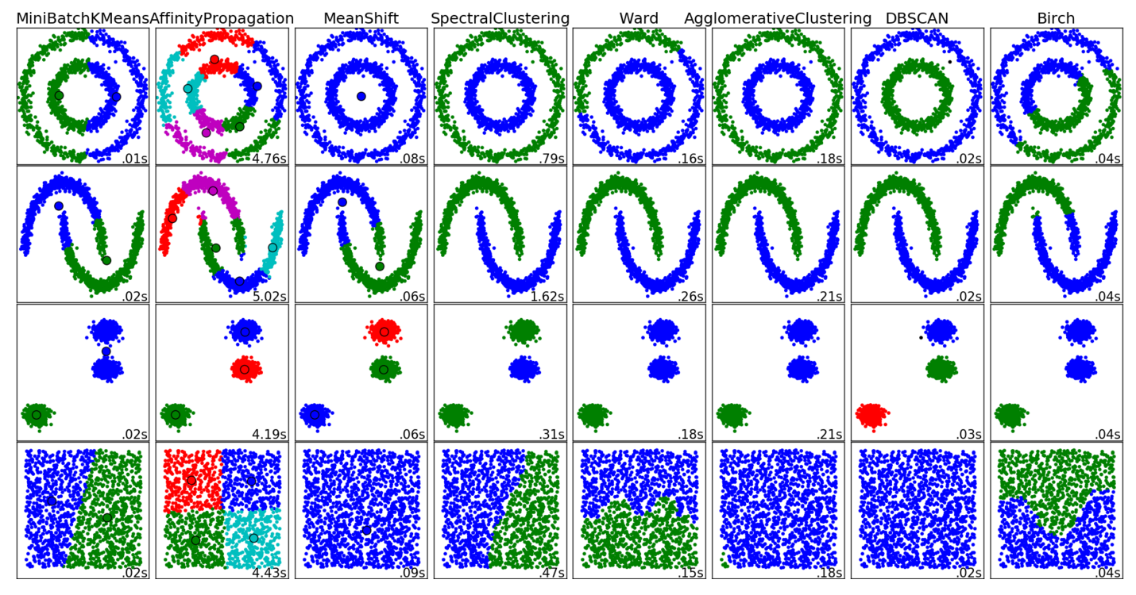
Visual model selection

Slide 28
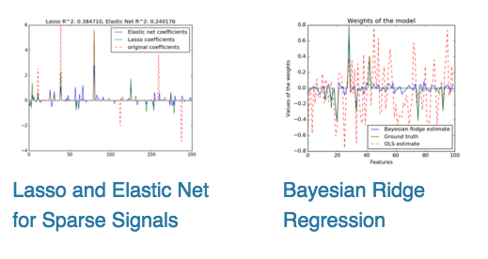
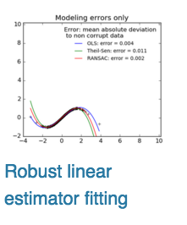
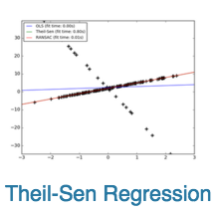
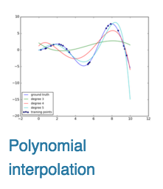
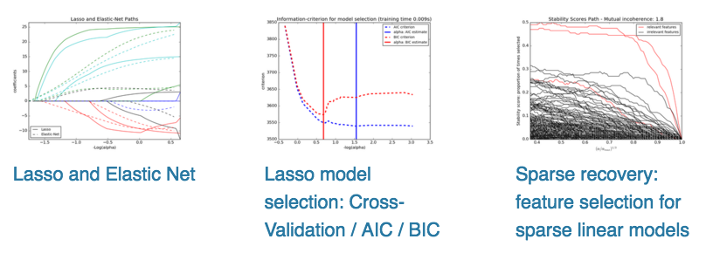
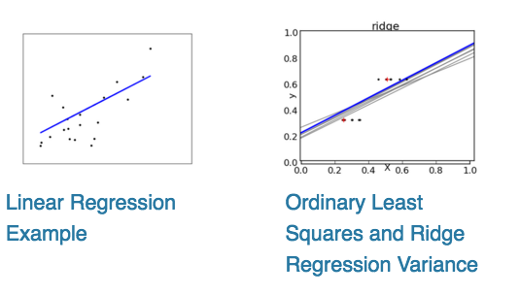
Visual model selection

Slide 29
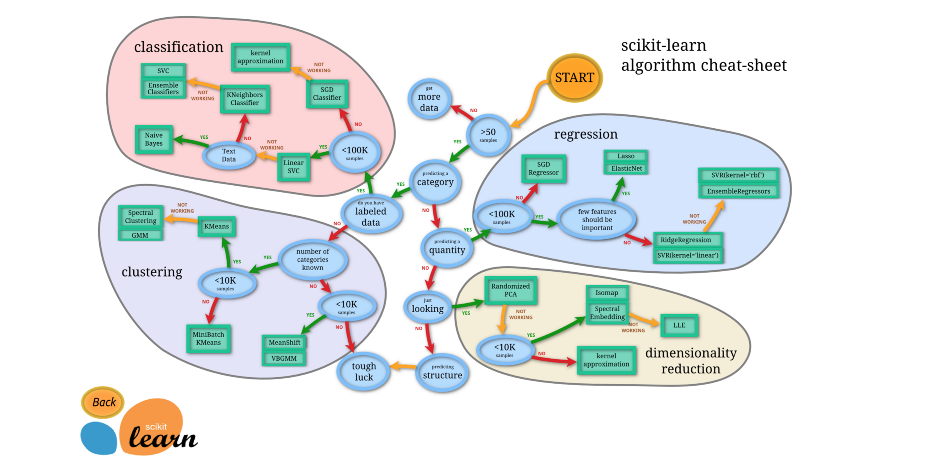
Visual model selection

Slide 30
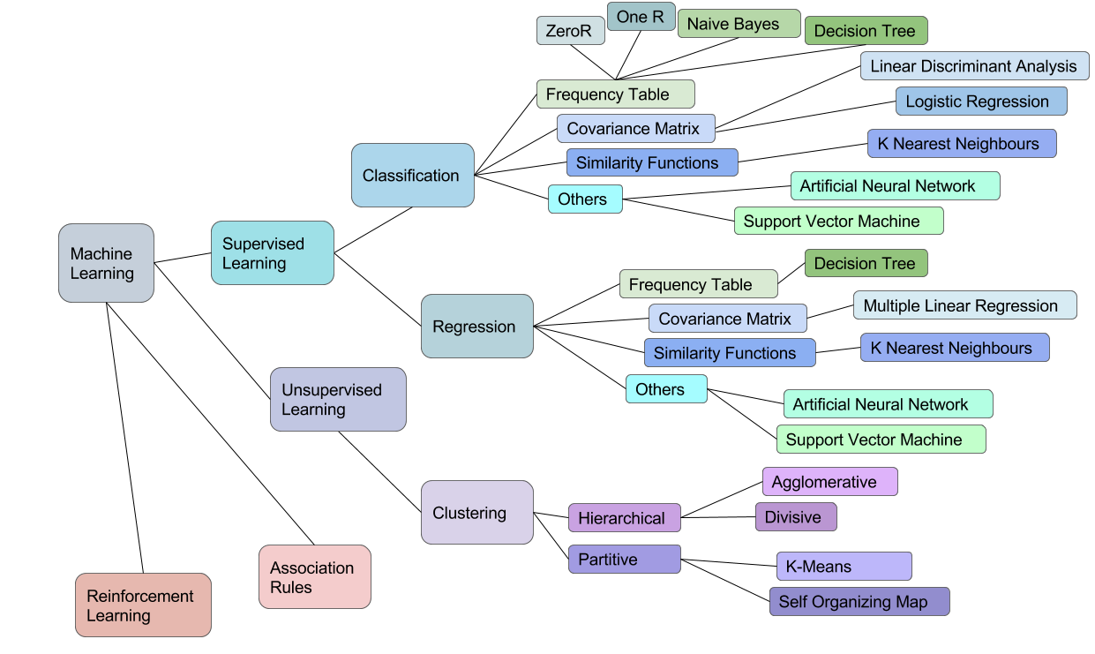
Visual model selection

Slide 31
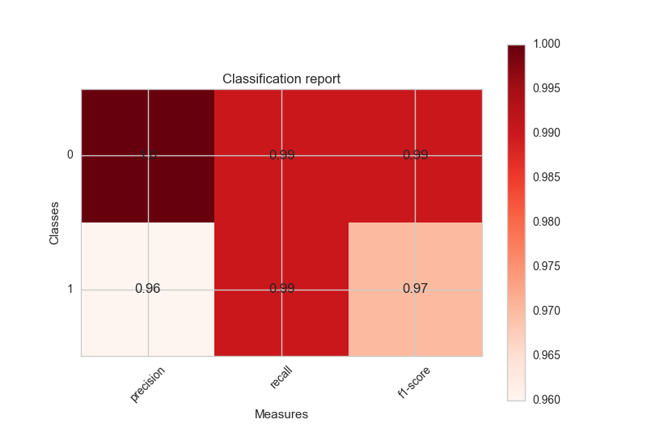
Visual evaluation

Slide 32
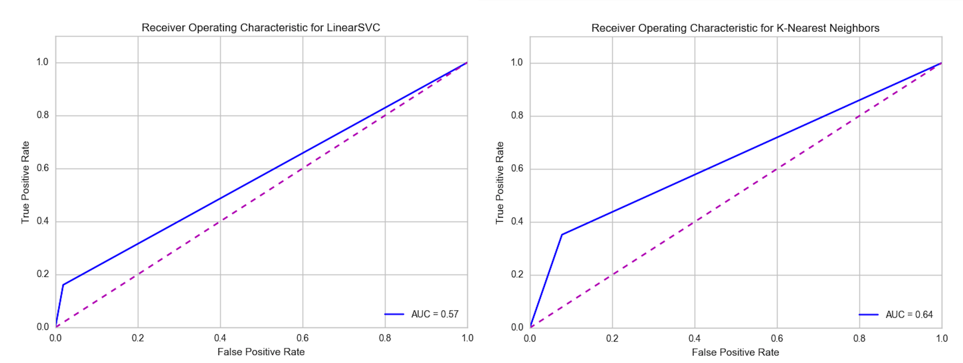
Visual evaluation

Slide 33
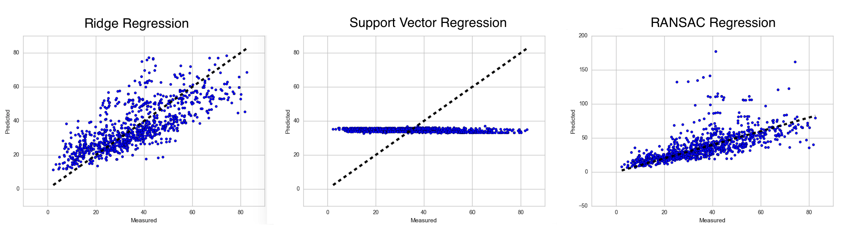
Visual evaluation

Slide 34
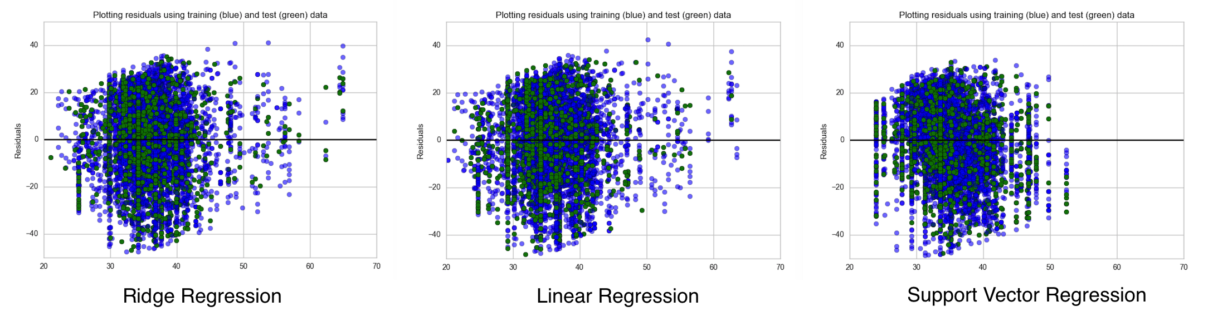
Visual evaluation

Slide 35


Slide 36
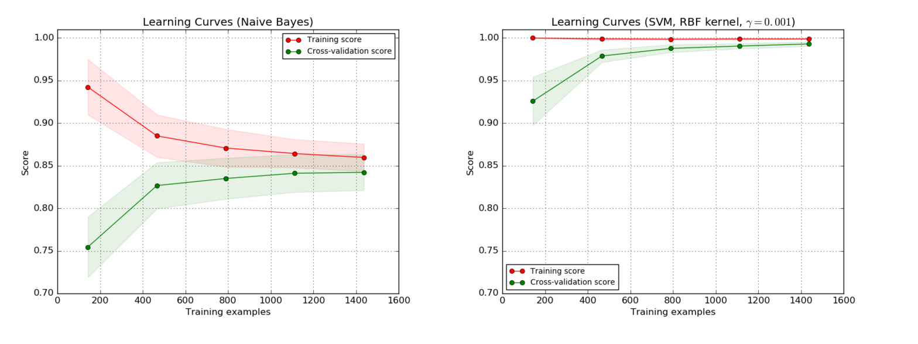
Visual tuning

Slide 37
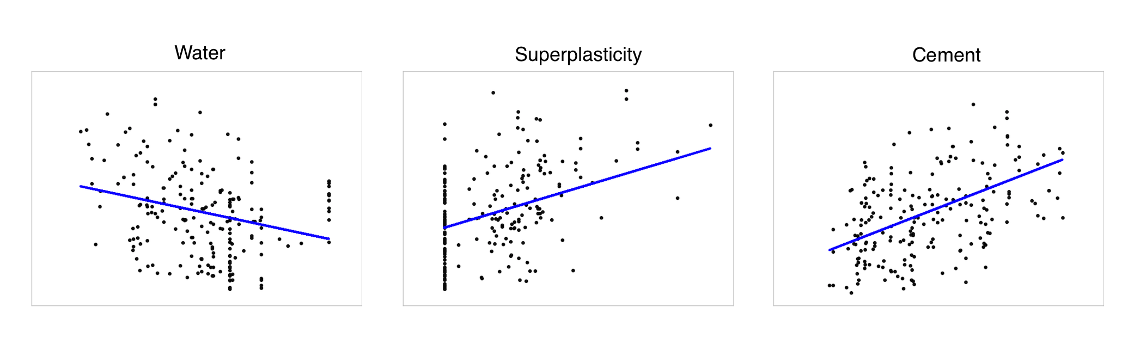
Visual tuning

Slide 38
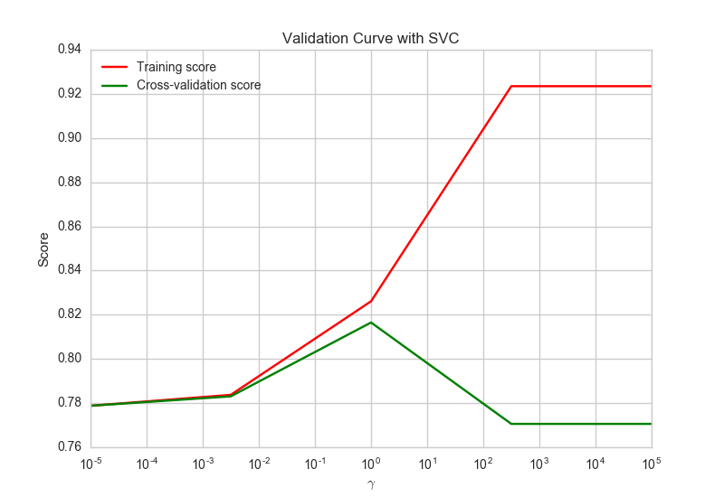
Visual tuning

Slide 39
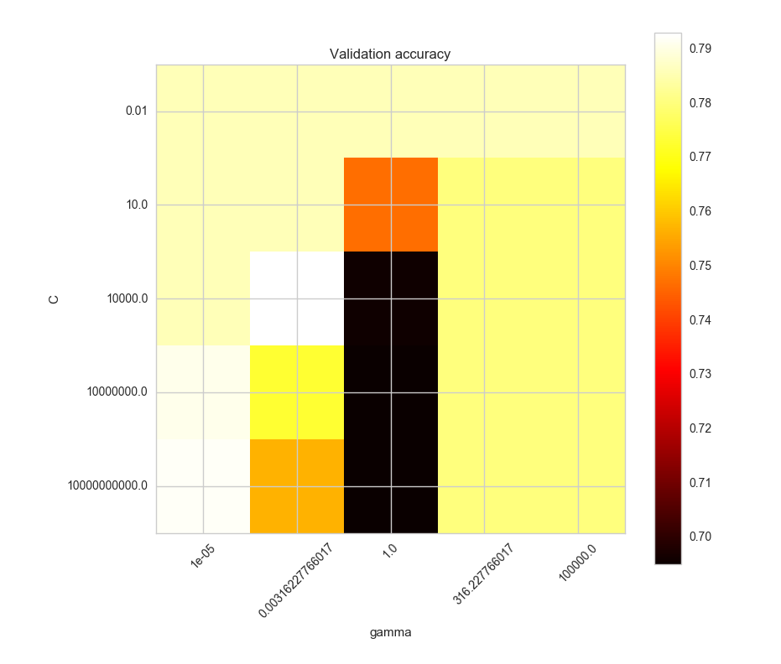
Visual tuning

Slide 40
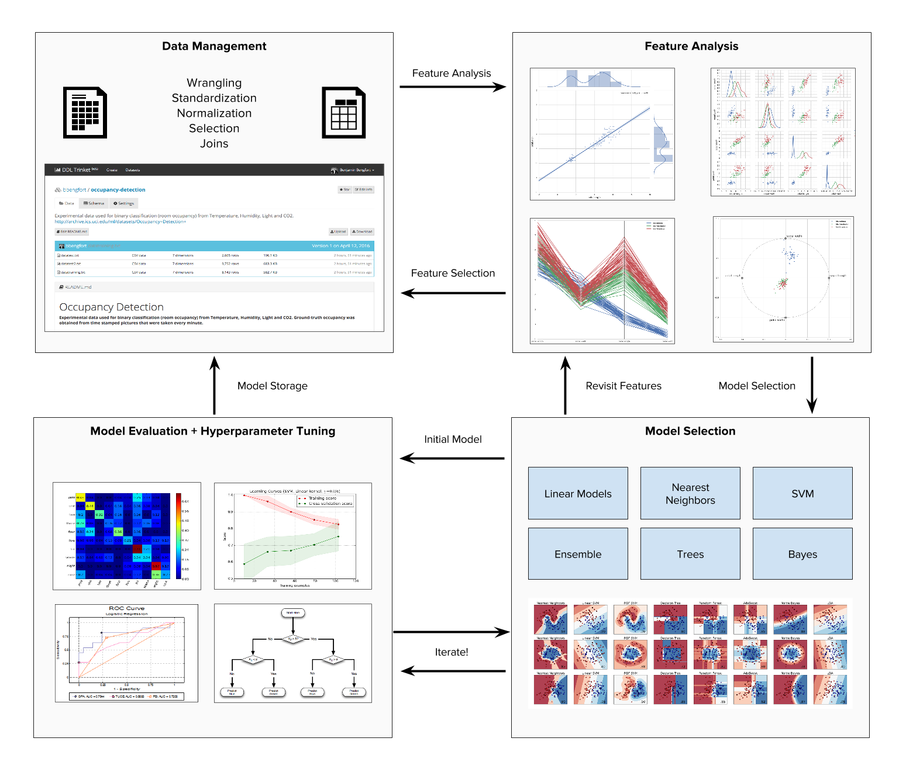
Workflow
1. feature engineering
2. algorithm selection
3. parameter tuning

Slide 41

Notes:
http://motionpictureimaging.com/wp-content/uploads/sites/8/2012/07/wizard-of-oz-updated-1.jpg

Slide 42

Wishlist
Notes:
http://pages.cs.wisc.edu/~arun/vision/SIGMODRecord15.pdf

Slide 43
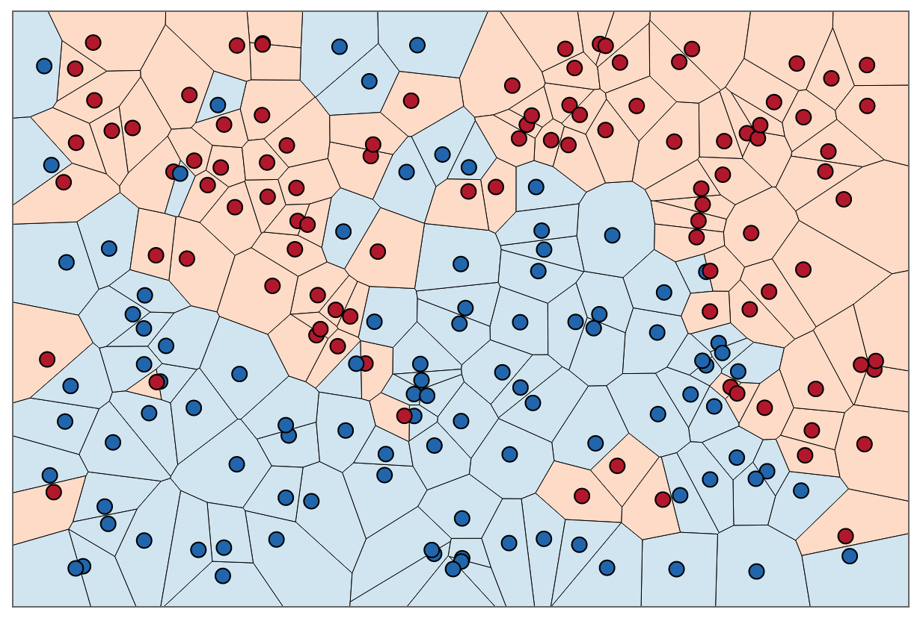
Wishlist
KNN
Notes:
http://scott.fortmann-roe.com/docs/BiasVariance.html

Slide 44
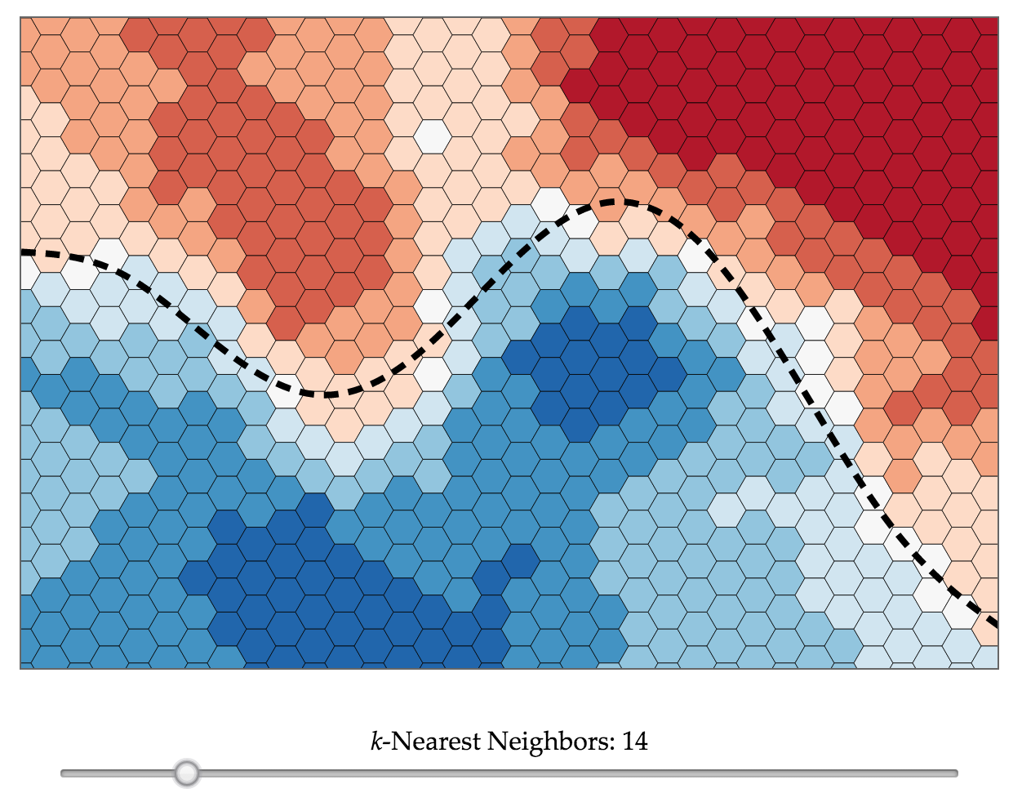
Wishlist
Notes:
http://scott.fortmann-roe.com/docs/BiasVariance.html

Slide 45
Notes:
http://scott.fortmann-roe.com/docs/BiasVariance.html

